Slide 1
FL VMUG 2023 Thinking about our careers
By Ariel Sanchez

Slide 2
A bit about me
Costa Rican in Orlando via SJO, Denver, NYC, PGH
Advocate of the vCommunity (vBrownBag, vExpert, VMUG, Hackathons, vBeers, etc!)
I want to help you present at your VMUG!
vExpert PRO – I’ll help you prepare for vExpert
Senior Staff Technical Account Manager @VMware

Slide 3
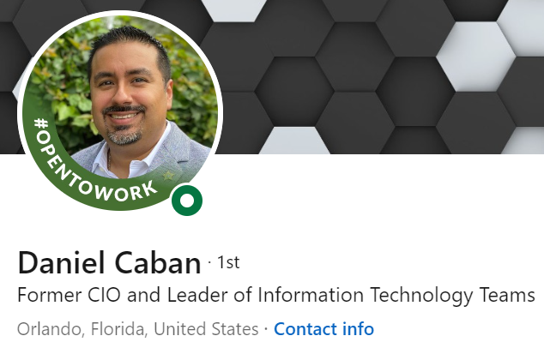
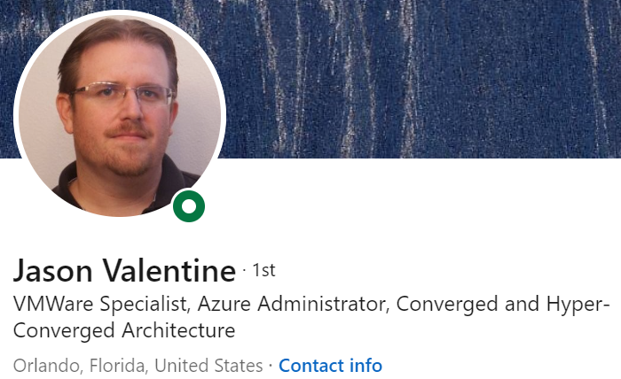
Daniel Caban and Jason Valentine

Slide 4
Agenda
2 Trends in IT, and what I think about them
Becoming a better version of yourself
Navigating change

Slide 5
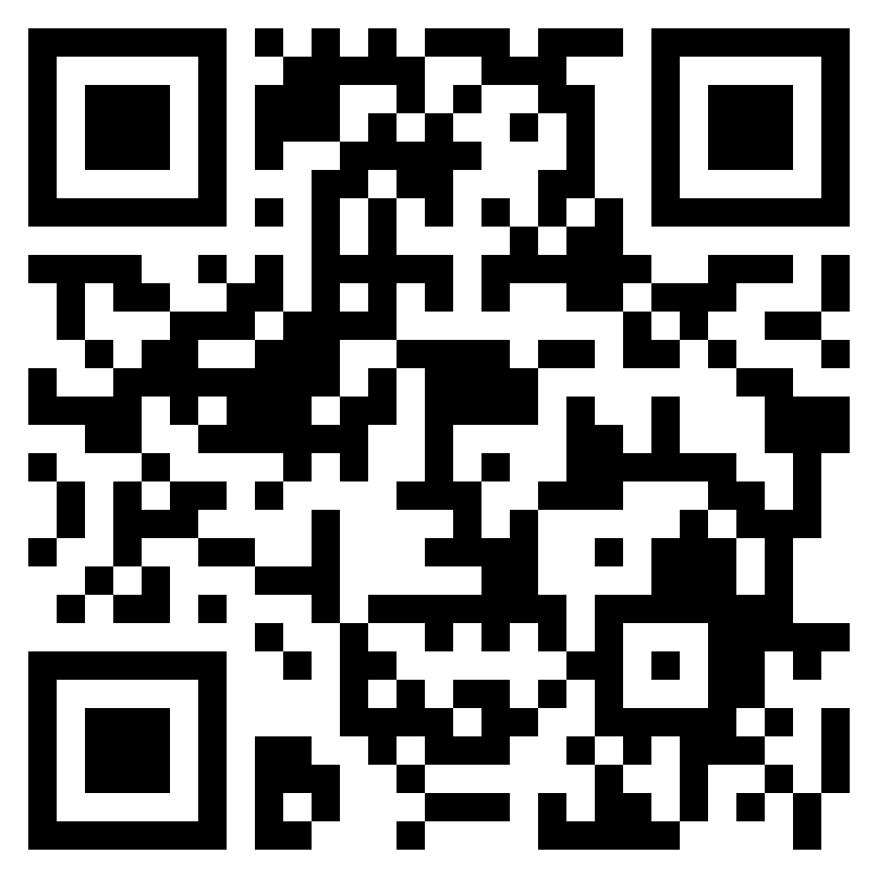
Ariel’s opinion of the 2023 IT landscape
This is what I feel we must do, in order to have successful and rewarding careers
https://github.com/arielsanchezmora/VMUG-Talks
Tweet or toot
#VMUG or #VMUG
Want to hear your feedback

Slide 6
Change is the only thing we are guaranteed
IT professionals have to welcome change
Technology changes rapidly, and it is not kind or considerate
As the future catches you

Slide 7
Adapting to change is crucial
Capitalism has two sides: The system creates an ever-growing pile of losers while concurrently delivering a gusher of improved goods and services. Schumpeter called this phenomenon “creative destruction.”
Warren Buffett Shareholder Letter 2022
Are you able to recall a company whose products were great? But that company was then acquired or otherwise went under. It is not enough then, to be great or have great products.

Slide 8
My 2 important trends in IT right now
Workload repatriation from cloud
One two three four articles and a tweet
“AI is going to take our jobs”, or, how ChatGPT is making everyone perk up about AI
ChatGPT Tweet search OpenAI tweet search

Slide 9
Cloud repatriation
We already knew the cloud, in a pure lift and ship, was going to be more costly than what you had on premises
Properly done, the Cloud paradigm is immensely powerful, and the proper operating model for many businesses/workloads
But – along came human nature. And an economic slowdown.

Slide 10
“Properly doing Cloud" is hard
Group 1: Sought reliable data, intelligent, honest, hard decisions, lots of talent across many people in the org, ongoing training, shrewd negotiating, excellent org communication…
Group 2: people make progress with a shared vision but with fragmented responsibilities; blockers that range from procedural to downright malicious with unrealistic expectations

Slide 11
This VMware Guy…
You might be skeptic. I am not defending or advocating. Cost, data security, latency, workload profile are the key factors.
VMware is investing in moving to a SaaS business model – and has invested heavily in the multi-cloud vision.
In VMware Explore last year, our CEO Raghu talked about companies wanting to be "cloud smart" and not "could first" anymore.

Slide 12
The real answer? It Depends
One of our best tools for questions like “Should we have a cloud first strategy?" or “Should we move everything to the cloud?".
Truthfully, few of us would put down their livelihood to guarantee a project's scope, success, ROI and scheduled completion. There's many variables.

Slide 13
How I would advice a friend
No matter what the vendor says - make your own decision. Research. Consult with colleagues. Get all the data you can.
Determine what conditions are needed for success and double check your assumptions.
Request a POC. The "crawl, walk, run" strategy makes a lot of sense. Wait for the bills to get paid. “Live” with it.
Communicate from the beginning this will be a process, and the feedback will loop into an improved version

Slide 14
How AI will change our lives
Large Language Models, and in particular OpenAI’s Generative Pre-trained Transformer, “went viral” with ChatGPT, based on GPT-3
When I first heard of it, I wasn’t impressed – many “holes”
But it caught on even outside tech circles, including my wife
GPT-4 is even more capable

Slide 15
OpenAI and siblings are very well funded
Recommend reading the OpenAI wikipedia. GPT-3 was trained with 10k Nvidia GPUs. MS gave them $10 billion to use their software in Bing and Office365. Bard is Google’s answer, and Meta has LLaMA.
Labor market impact potential study tweet with graph
… approximately 80% of the U.S. workforce could have at least 10% of their work tasks affected by the introduction of GPTs, while around 19% of workers may see at least 50% of their tasks impacted…

Slide 16
Will AI take my IT job?
Is my value to my employer and customers higher than what a well funded AI can deliver?
You have important advantages
The internet is, honestly, full of not great data, some downright wrong. Our industry prizes being right.
We have relationships (that an AI won’t replace soon) and private lives and details not posted on the internet

Slide 17
Change is the only thing we are guaranteed
AI technology will only improve. And get cheaper
I still have 20+ years of IT career ahead of me.
We must welcome change, be informed, and be ready to lead
AI/ML and Data processing may become the most important workload of the next decade

Slide 18
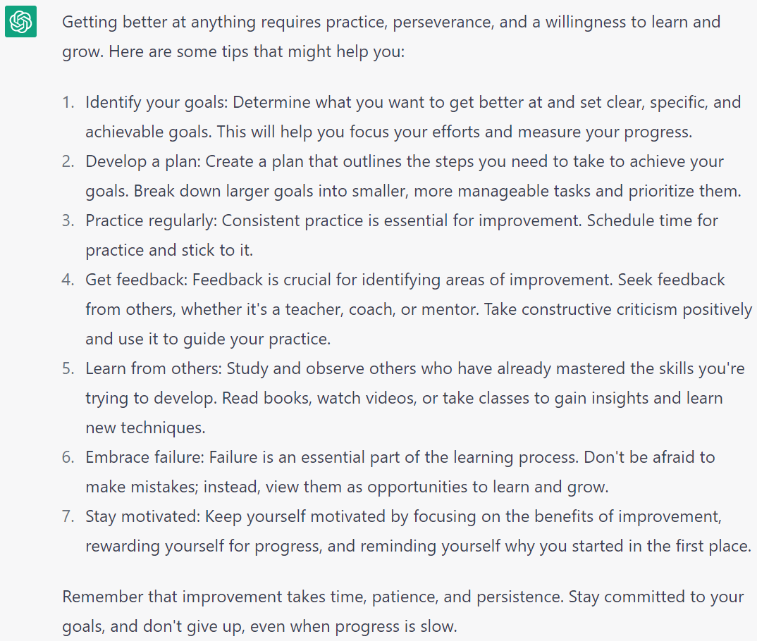
Let’s pivot from data to action
How do I get better?
How do I learn, grow, get recognized and promoted, and prepare for my next job title?

Slide 19
Ariel’s tips for career impact
Summarized:
Learn new information through reading and mentorship
Grow your network, influence and personal brand
Focus on things that will bring the outcome you desire
Take care of yourself and yours

Slide 20
Gather information and make a plan
We need clarity to define what we want to become
Step 2 should be seeking mentors and role models that can get us there
Some will be people we have access to, but we can learn a lot at our own pace with a library card and a few dollars, in books
You need to read to become better. Even if it’s on your phone, seek quality sources of information.

Slide 21
Make reading part of your habits
Make it a point to ask your bosses, colleagues, loved ones - what are they reading? What did they learn, and do they recommend it?
List of books I've read that have shaped me
Most have to make mistakes to learn the lesson. The wise learn from other's mistakes. The foolish don't learn from their mistakes.

Slide 22
Cultivate your network
Your network is the relationships you can count on; build it with respect and consideration, invest time to keep it healthy and growing.
Rely on it for:
Mentoring and career growth
Knowledge, sounding board and help building solutions
Be useful, and be reliable, and watch yourself be rewarded

Slide 23
Build your trusted groups and listen
Mentors,
Mentees,
Reverse mentors,
Seek a trusted group that tells you the hard truths and your weaknesses, and is willing to help you overcome them
Ask for feedback and evaluate it. Here’s a great book on listening

Slide 24
Understand your personal brand
Amanda Blevins has done a great session on this
Can you describe what you are known for?
Do people outside of your colleagues, manager, silo, company know the great things you do?
How would someone find this information?
It’s in your interest to get better at public speaking
Brag! The art of tooting your own horn without blowing it

Slide 25
Focus on the crucial activities
80% of outcomes are caused by 20% of input
Focus on understanding what’s really going to move the needle
Work with your manager to identify these crucial activities
Put yourself in your manager’s shoes
Make sure your goals are well understood by your manager

Slide 26
Candor cuts through vagueness
My favorite chapter in Winning
We must find a balance in our relationships where we can speak openly with our superiors and colleagues
Aim to be factual, respectful, well-meaning and collaborative
Use candor with your manager – understand where you are and find out if they will help you get to your next step.

Slide 27
Take care of what’s important
Your physical health
Your mental health
Your relationship health
Your stress levels at work
Your financial health
Your spiritual health
The richest people value their relationships more than anything

Slide 28
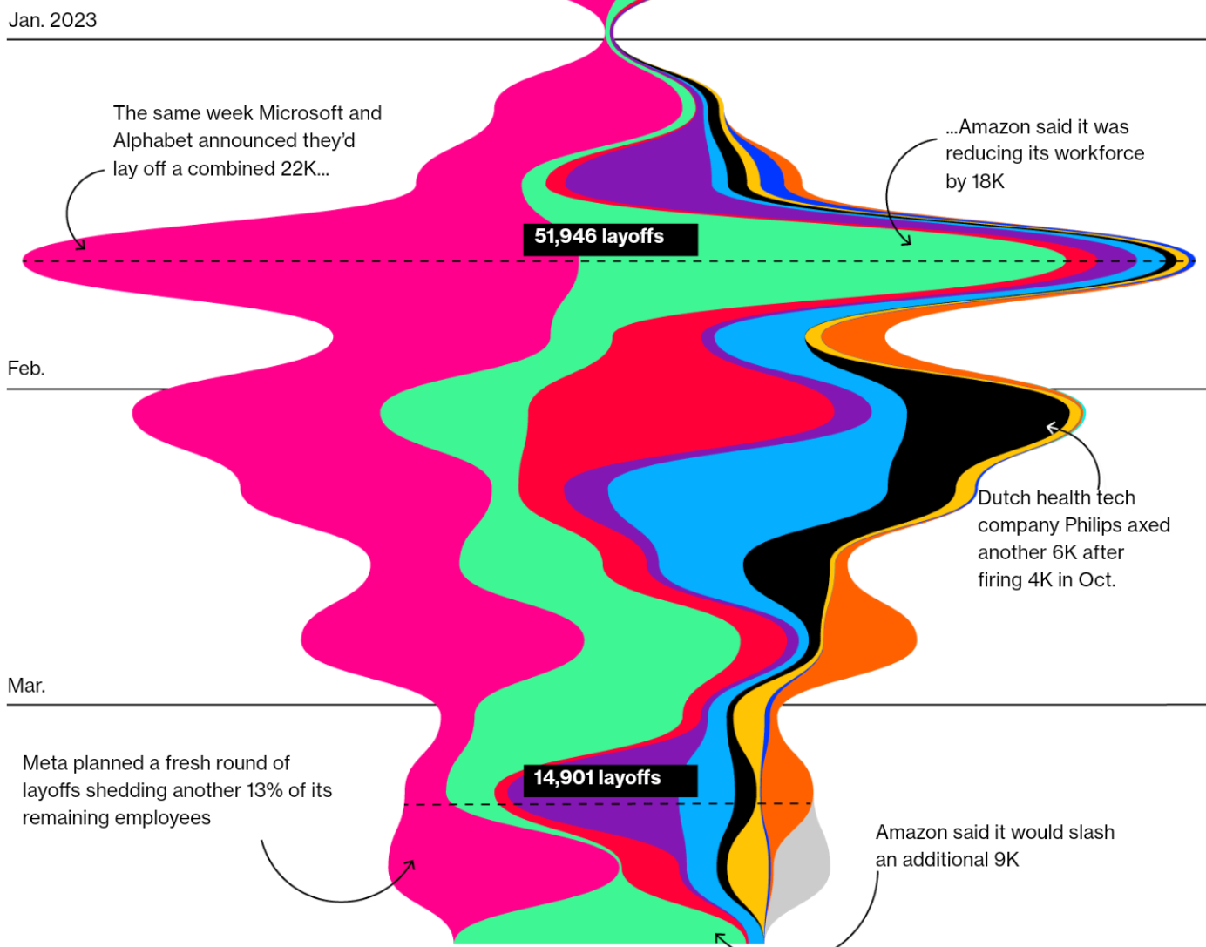
Navigating change in 2023
2023 marks a change in the whole market, esp Tech
Lots more talent are looking for a job
Or becoming cloud solopreneurs
Resume and LinkedIn tips

Slide 29
Should I stay or go?
Always evaluate risk and reward, pros and cons,
Compensation is both $ and the skills you’re learning
What got you here won’t get you there
Does it improve what’s important to me?
How much growth/opportunities would I be leaving behind?
Am I doing great in a company with a bad future?
Am I through with my boss?
What’s my backup plan?

Slide 30
How VMUG can help you be better
VMUG itself is a part of what we call the #vCommunity
I made a presentation that shows you how to take advantage of it:
Use social media to your professional advantage
Seek mentors, grow your network and create trust groups
Make a VMUG leader happy and present at the local meetings

Slide 31
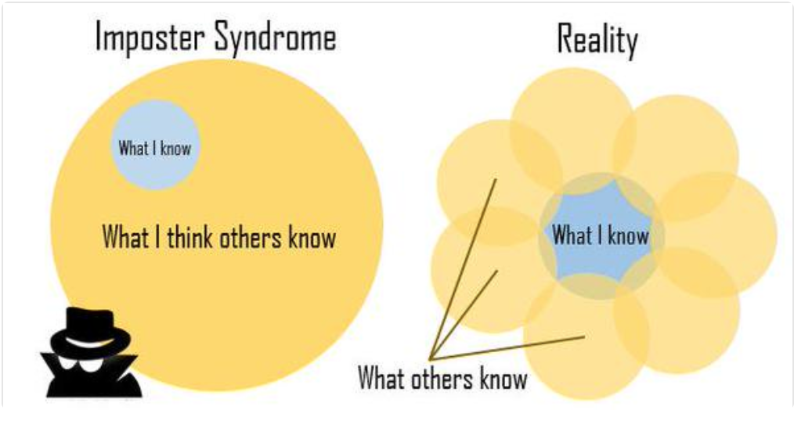
Contributing
Overcoming "I don’t have anything to share"

Slide 32
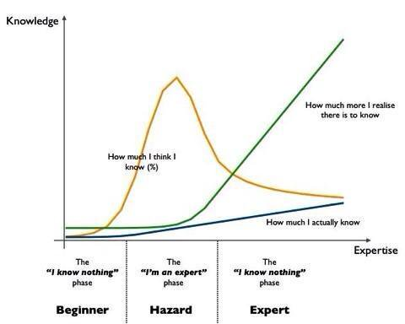
We’re all on our own journey, and we have to re-invent ourselves every so often anyways

Slide 33

FL VMware User Groups
These VMware User Groups in FL are our community
We will run into similar tech challenges, and we'll rely on each other to learn how to overcome them in the best ways
This is also our sounding board for our careers

Slide 34
Thank you!
Twitter.com/arielsanchezmora (still, for vCommunity)
https://vmst.io/@arielsanchezmora
https://github.com/arielsanchezmora/VMUG-Talks
https://github.com/arielsanchezmora/vSphere-67-Upgrade-to-7u3/blob/main/README.md

